Slide 1
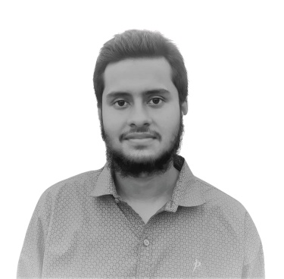

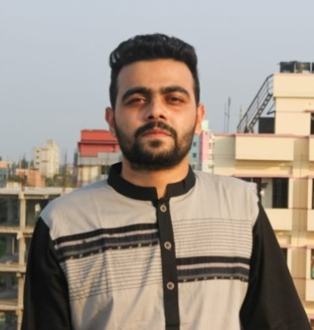
PROJECT PRESENTATION Made By
Muhammad Rifat
MD Abid Hossain
Rafi Chowdhury

Slide 2

PROJECT TITLE
THE SMART ONLINE DIARY
Presented By
MD Abid Hossain

Slide 3
Introduction
This presentation will provide a highlighted and summarized information about the project we have completed.

Slide 4
Project Overview
It’s a smart web based diary where people can share their feeling and store them. Anyone can signup/sign in and write something with an image attached to it. Also you can delete any post anytime you want.
It can also be used as a web based To-Do app.

Slide 5
Aims of the Solution
Provide a platform for online smart diary
The system will be completely free to use.
Users can write and store their daily activities.
Login through Google or signup using email
Users can delete any post.

Slide 6
Project Features
Login/Registration
Responsive Design
Post Daily Update
Can be used as a to-do list
Posts can be deleted
Image upload

Slide 7




Technology and Package Used

Slide 8
People Evolved with System Development
Muhammad Rifat
MD Abid Hossain
Rafi Chowdhury
Lead Developer
Backend Expert
Front-End Developer
Project Manager
Requirements
Analyst and Code Tester

Slide 9
Tools and Development Methodology
Agile (as Development Methodology)
Jira (As project management tool)

Slide 10
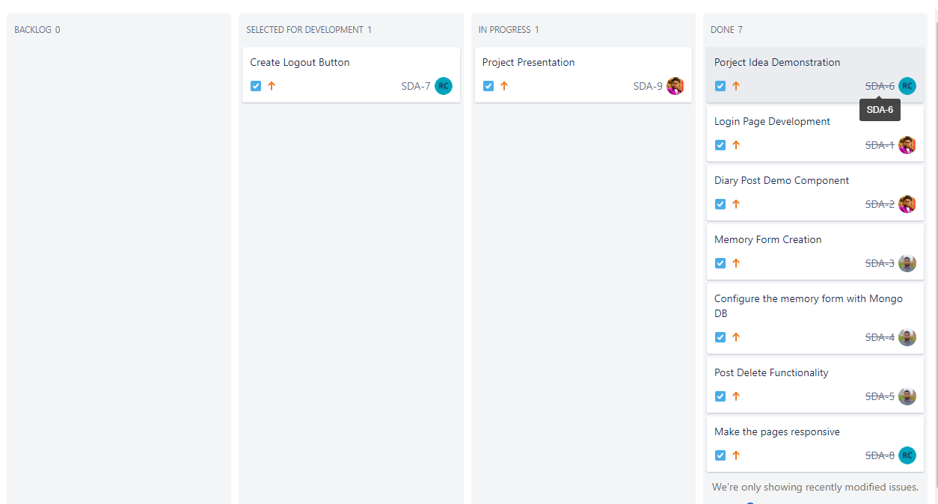
How we organized out development in Jira

Slide 11
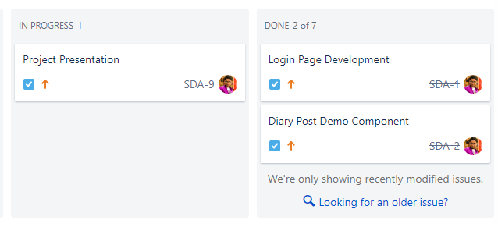
What I did as a contributor

Slide 12
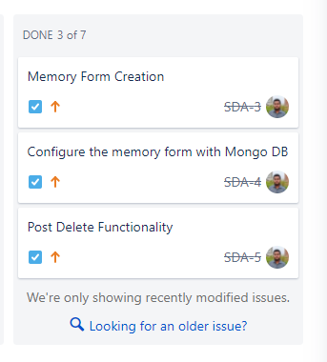
Here is what Mr. Rifat did

Slide 13
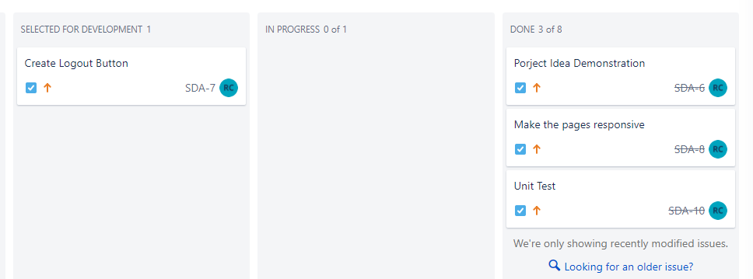
Here is what Mr. Rafi did

Slide 14
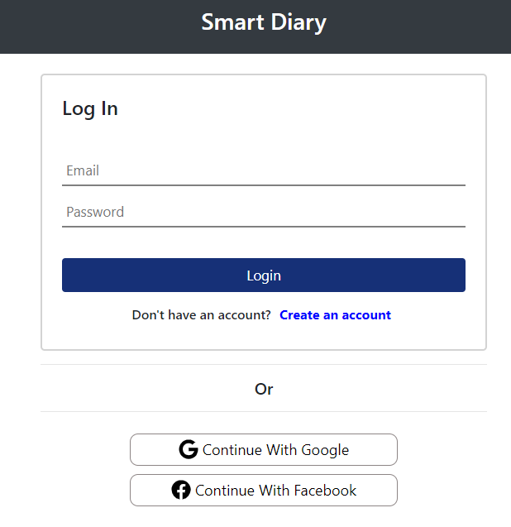
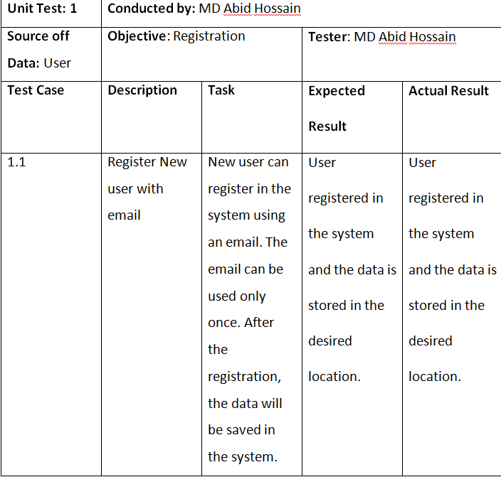
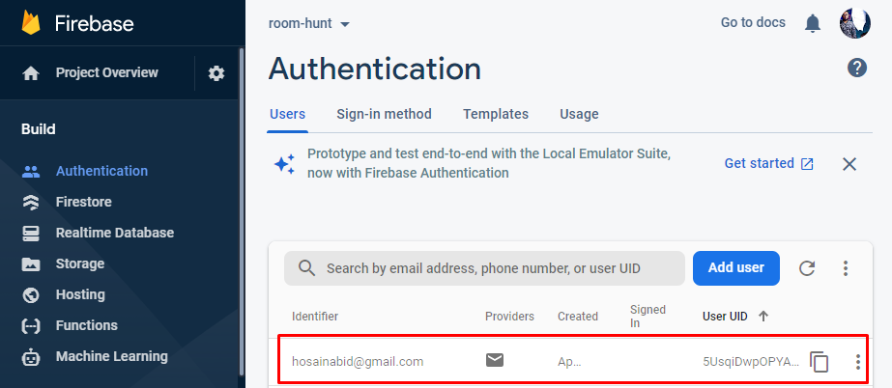
Unit Testing

Slide 15
Live Site Link
https://smart-diary-simple.web.app/
Github Link
https://github.com/hosainabid/smart-diary.git

Slide 16
Conclusion
We tried our best to develop a smart online diary system for everyone. Hope the design is efficient and it meets all the user requirements.

Slide 17
Any Questions?

Slide 18
THANK YOU SO MUCH!

